Slide 1
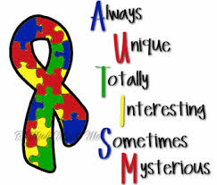
Autism:
The Basics & Strategies You Can Use!
Presented by: Molly Battaglini & Cori Dudakiw-Warrick

Slide 2
10 Things every child with autism wish you knew
I am a child with Autism. I am not “autistic”. It does not define me as a person.
My sensory perceptions are disordered. It means that the ordinary sights, sounds, smells, tastes, and touches of everyday that you may not notice can be painful for me.
Please remember to distinguish between what I choose not to do and what I am not able to do. It is not that I don’t listen to instruction, it’s that I can’t understand you.
I am a concrete thinker. Meaning, I interpret language very literally. Don’t tell me something is a “piece of cake” when there is no dessert in sight. Just say “this will be easy for you to do.”
Please be patient with my limited vocabulary. It’s hard for me to tell you what I need when I don’t know the words to describe my feelings.

Slide 3
10 Things continued…
6. I am visually oriented. Please show me how to do something rather than just telling me. Please be prepared to show me many times because repetition helps me to learn.
7. Please focus and build on what I can do, rather than what I can’t do. Look for my strengths and you will find them. There is more than one “right” way to do most things.
8. Please help me with social interactions. It may look like I don’t want to play with others, but sometimes I don’t know how to start a conversation. Encourage kids to invite me to join them. It may be that I’m delighted to be included.
9. Try to identify what triggers my meltdowns because they are even more horrid for me than they are for you. They occur because one or more of my senses has gone into overload.
10. Love me unconditionally. Banish thoughts like “If he would just…” and “Why can’t she…”. I do not choose to have autism. Remember that it is happening to me, not you. With your support and guidance, my possibilities are broader than you might think. I promise you – I am worth it.

Slide 4
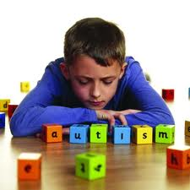
What is Autism?
Autism Spectrum Disorder/Autism
  Complex disorders of brain development
Difficulties with:
  Social Interactions
  Verbal & Nonverbal Communication
  Repetitive Behaviors

Slide 5
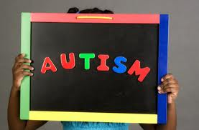
Autism and
Autism Spectrum Disorders
Autism
Asperger Syndrome
Rett Syndrome
Childhood Disintegrative Disorder
Pervasive Developmental Disorder- Not Otherwise Specified (PPD-NOS)

Slide 6
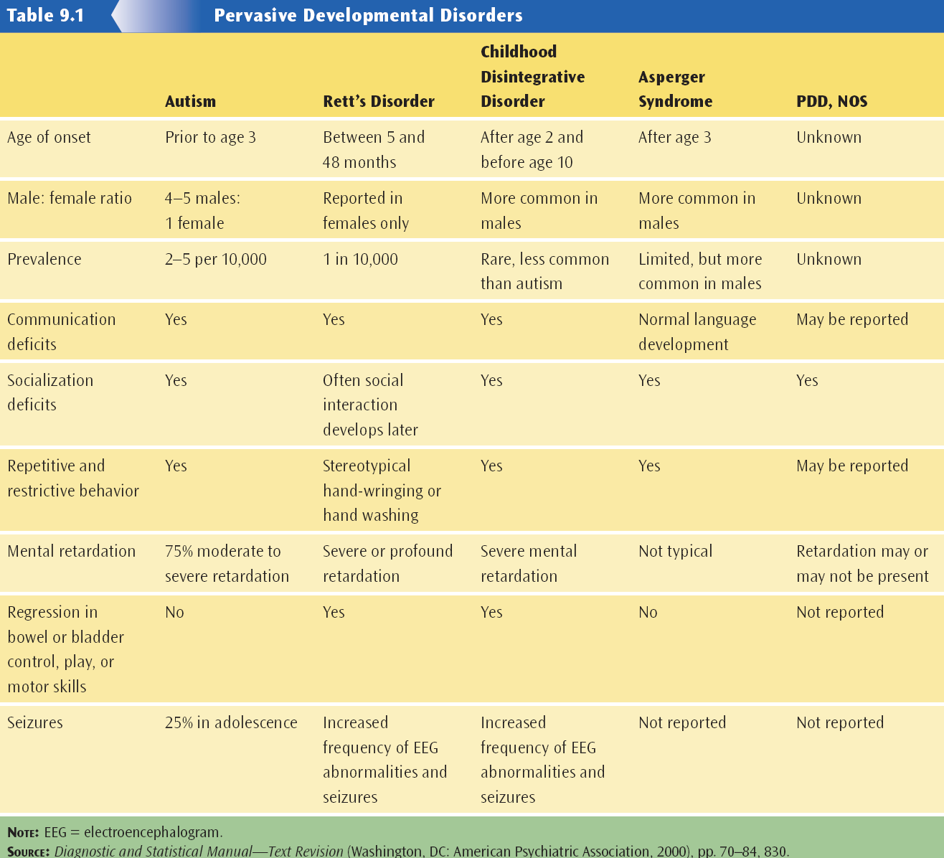

Slide 7
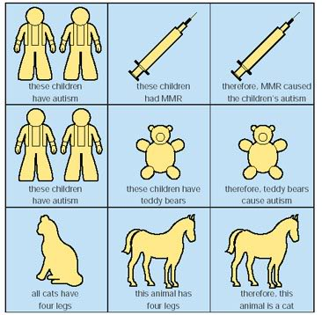
Suspected Etiologies of
Autism Spectrum Disorders
No single cause
Genetic link
Brain abnormalities
Neurochemical research
Vaccinations

Slide 8
Sensory Integration Problems
An acute awareness of background noises
Fascination with lights, fans, water
Spinning items, taking things apart
Little awareness of pain or temperature
Coordination problems
Self-injury or aggression
Hand flapping/repetitive movements
Difficulty with transitions
The child may react strongly to stimuli on face, hands, and feet
An unusual sensitivity to sounds and smells
Frequently adjusts clothing, pushing up sleeves and/or pant legs

Slide 9
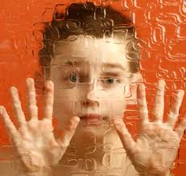
Characteristics of Autism
Repetitive behavior
  Obsessions, tics, and perseverations
Problem behavior
  Self-injurious behavior
  Aggression
Need for environmental predictability
Sensory and movement disorders
Intellectual functioning
  Savant syndrome

Slide 10

Proactive classroom suggestions
Avoid abstract ideas
Avoid using confusing speech
Break down tasks
Prepare students for changes
Adjust auditory and visual distractions
Facilitate group work

Slide 11
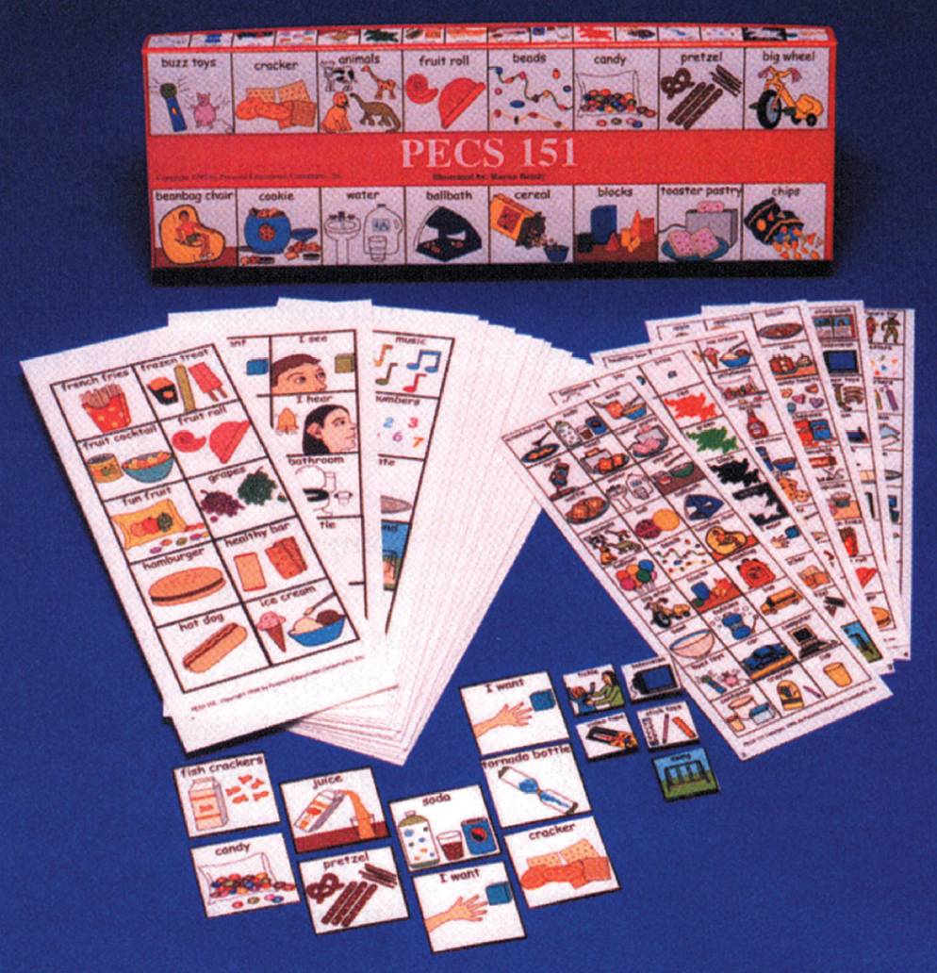
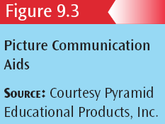
Picture Communication Aids

Slide 12

Structured Social Interactions
Successful social interaction will likely require structured intervention.
Structured free time activities - e.g., playground, before and after school.
Structure social problems in classroom.

Slide 13
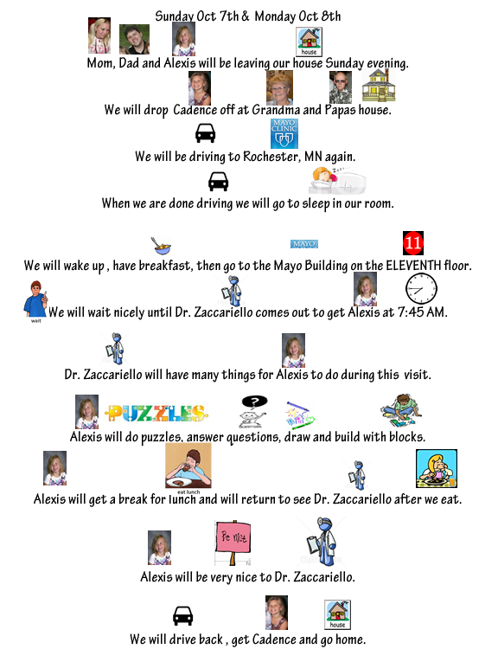
Social stories, social scripts
Use of Social Stories (e.g., Carol Gray - http://www.thegraycenter.org/social-stories/carol-gray).
Overly-scripted behavioral strategies to govern behavior in common trouble areas

Slide 14
Writing a Social Story
A Social Story is usually a first-person, present-tense story used to provide a student with as much information about a social situation as possible, so s/he is better prepared to face, and act appropriately in that situation.
There are four types of sentences used to present this information in a Social Story:
  Descriptive sentences objectively address the “wh” questions: where the situation takes place, who is involved, what they are doing, and why they may be doing it.
  Perspective sentences give a peek into the minds of those involved in the story; they provide details about the emotions and thoughts of others.
  Directive sentences suggest desired responses tailored to the individual.
  Control sentences are authored by the student himself as something of a mnemonic device -- a sentence to help him remember the story or deal with the situation. These are not used in every story and are typically used only with fairly high functioning children.

Slide 15
Structure the Lesson
I have to complete 1 2 3
Choose:
I am working for:

Slide 16
The Need to a Provide Predictable Environment
Graphic schedules and task/activity pages
Social stories/Social Scripts
Effective communication system (Picture Exchange Communication System)
^{Bookbag}
^{Locker}
^{Notebook}

Slide 17
Sensory Diet
A “sensory diet” is a carefully designed, personalized activity plan that provides the sensory input a person needs to stay focused and organized throughout the day.
Activities that are calming:
  Sucking (e.g., a thick shake through a straw, hard candies, or a popsicle).
  Slow rhythmic movement, rocking or swinging.
  Cuddling, or wrapping a blanket around the shoulders.
  Pushing against walls with the hands, sides of the body, back and buttocks.
Activities that are alerting:
  Light touch, light tickles with a feather, back scratch, koosh ball.
  Fast, irregular movement, bouncing on a therapy ball, playing tag and jumping.
  Crunchy foods: pretzels, crackers, popcorn, or raw vegetable sticks.

Slide 18
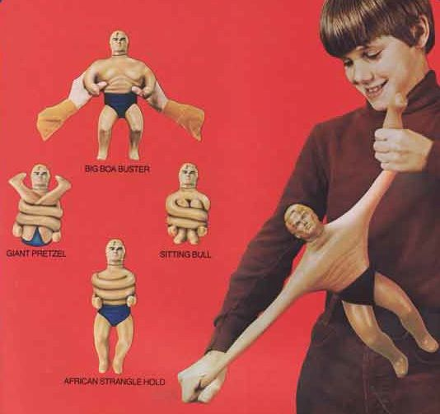
Sensory Diet (Continued)
Activities that are alerting:
  Pushing and pulling activities; playing with a “Stretch Armstrong” toy or stiff clay, pushing a loaded cart.
  Moving furniture, putting up chairs.
  Hiking, climbing, tug-a-war.
  Carrying and passing out books.
  Chewy foods: gum, bagels, fruit bars, dried fruit, etc.

Slide 19
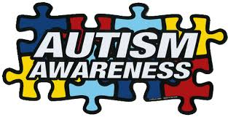
THANK YOU!!!
If you have any other questions or want more resources, let us know! I have lots of great information! ☺

